Slide 1

HCI - Assignment n.2
Design and prototyping of an application using a human-centered approach
Deliverable n. 1: Requirement Analysis
Project Title: XYZ an application for …
Group: Alice, Bob & Carol
Lab Class: PX
HCI 2020-2021

Slide 2
Introduction
Insert project title here
Brief contextualization / motivation.
Why this project?
Relation to other courses? (e.g. Data Bases, Project…; optional)
Personal Interest? Elaborate.
….
HCI 2020-2021
2

Slide 3
Project Objectives
Insert project title here
Define high-level goals.
What are the expected outcomes?
What are the benefits?
HCI 2020-2021
3

Slide 4
Personas
Insert project title here
Select 1 or 2 main target users;
Define the corresponding personas:
Include name, gender, age, profession, background, main motivations, goals and needs …
Do not void too much detail (include only information relevant to your problem
HCI 2020-2021
4

Slide 5
Scenarios
Insert project title here
Define context of use through 1 or 2 main scenarios including the personas you have defined
Define short concepts or descriptions of how users (personas) will use the application
Should not go into too much detail
HCI 2020-2021
5

Slide 6
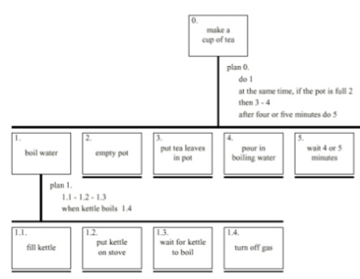
Tasks
Insert project title here
For each scenario indicate the main tasks that users will perform using the application;
Identify relevant issues of the context of use, if necessary (e.g. mobile usage, noise, dust, stress level, etc.);
Which tasks will become easier using the application (taking advantage of the new capacities) and how they are performed currently (without the application)?
Include the decomposition of the main task.
HCI 2020-2021
6

Slide 7
Requirements
Insert project title here
Define a set of requirements (non-functional, functional, …) based on the objectives and personas:
Non-functional requirements – specify the main usability requirements
(ease of learn or ease of use? …) and other that would be the most relevant (privacy, …);
Functional Requirements - specify the main functionality the application should support.
HCI 2020-2021
7

Slide 8
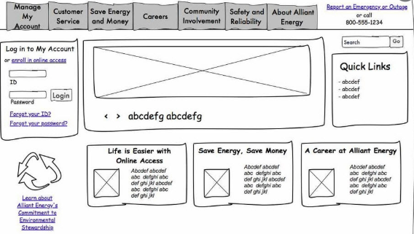
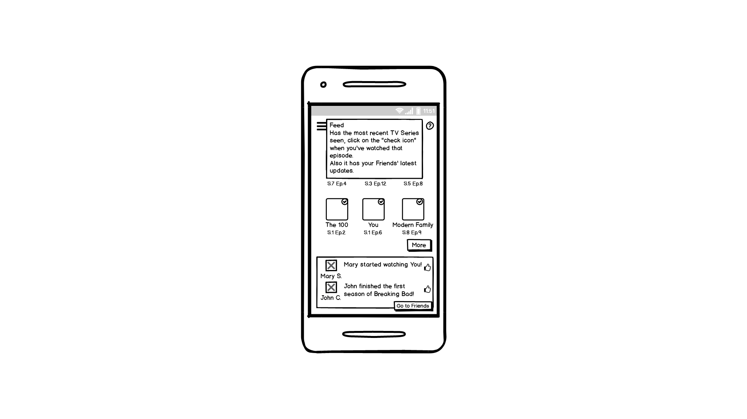
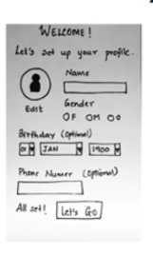
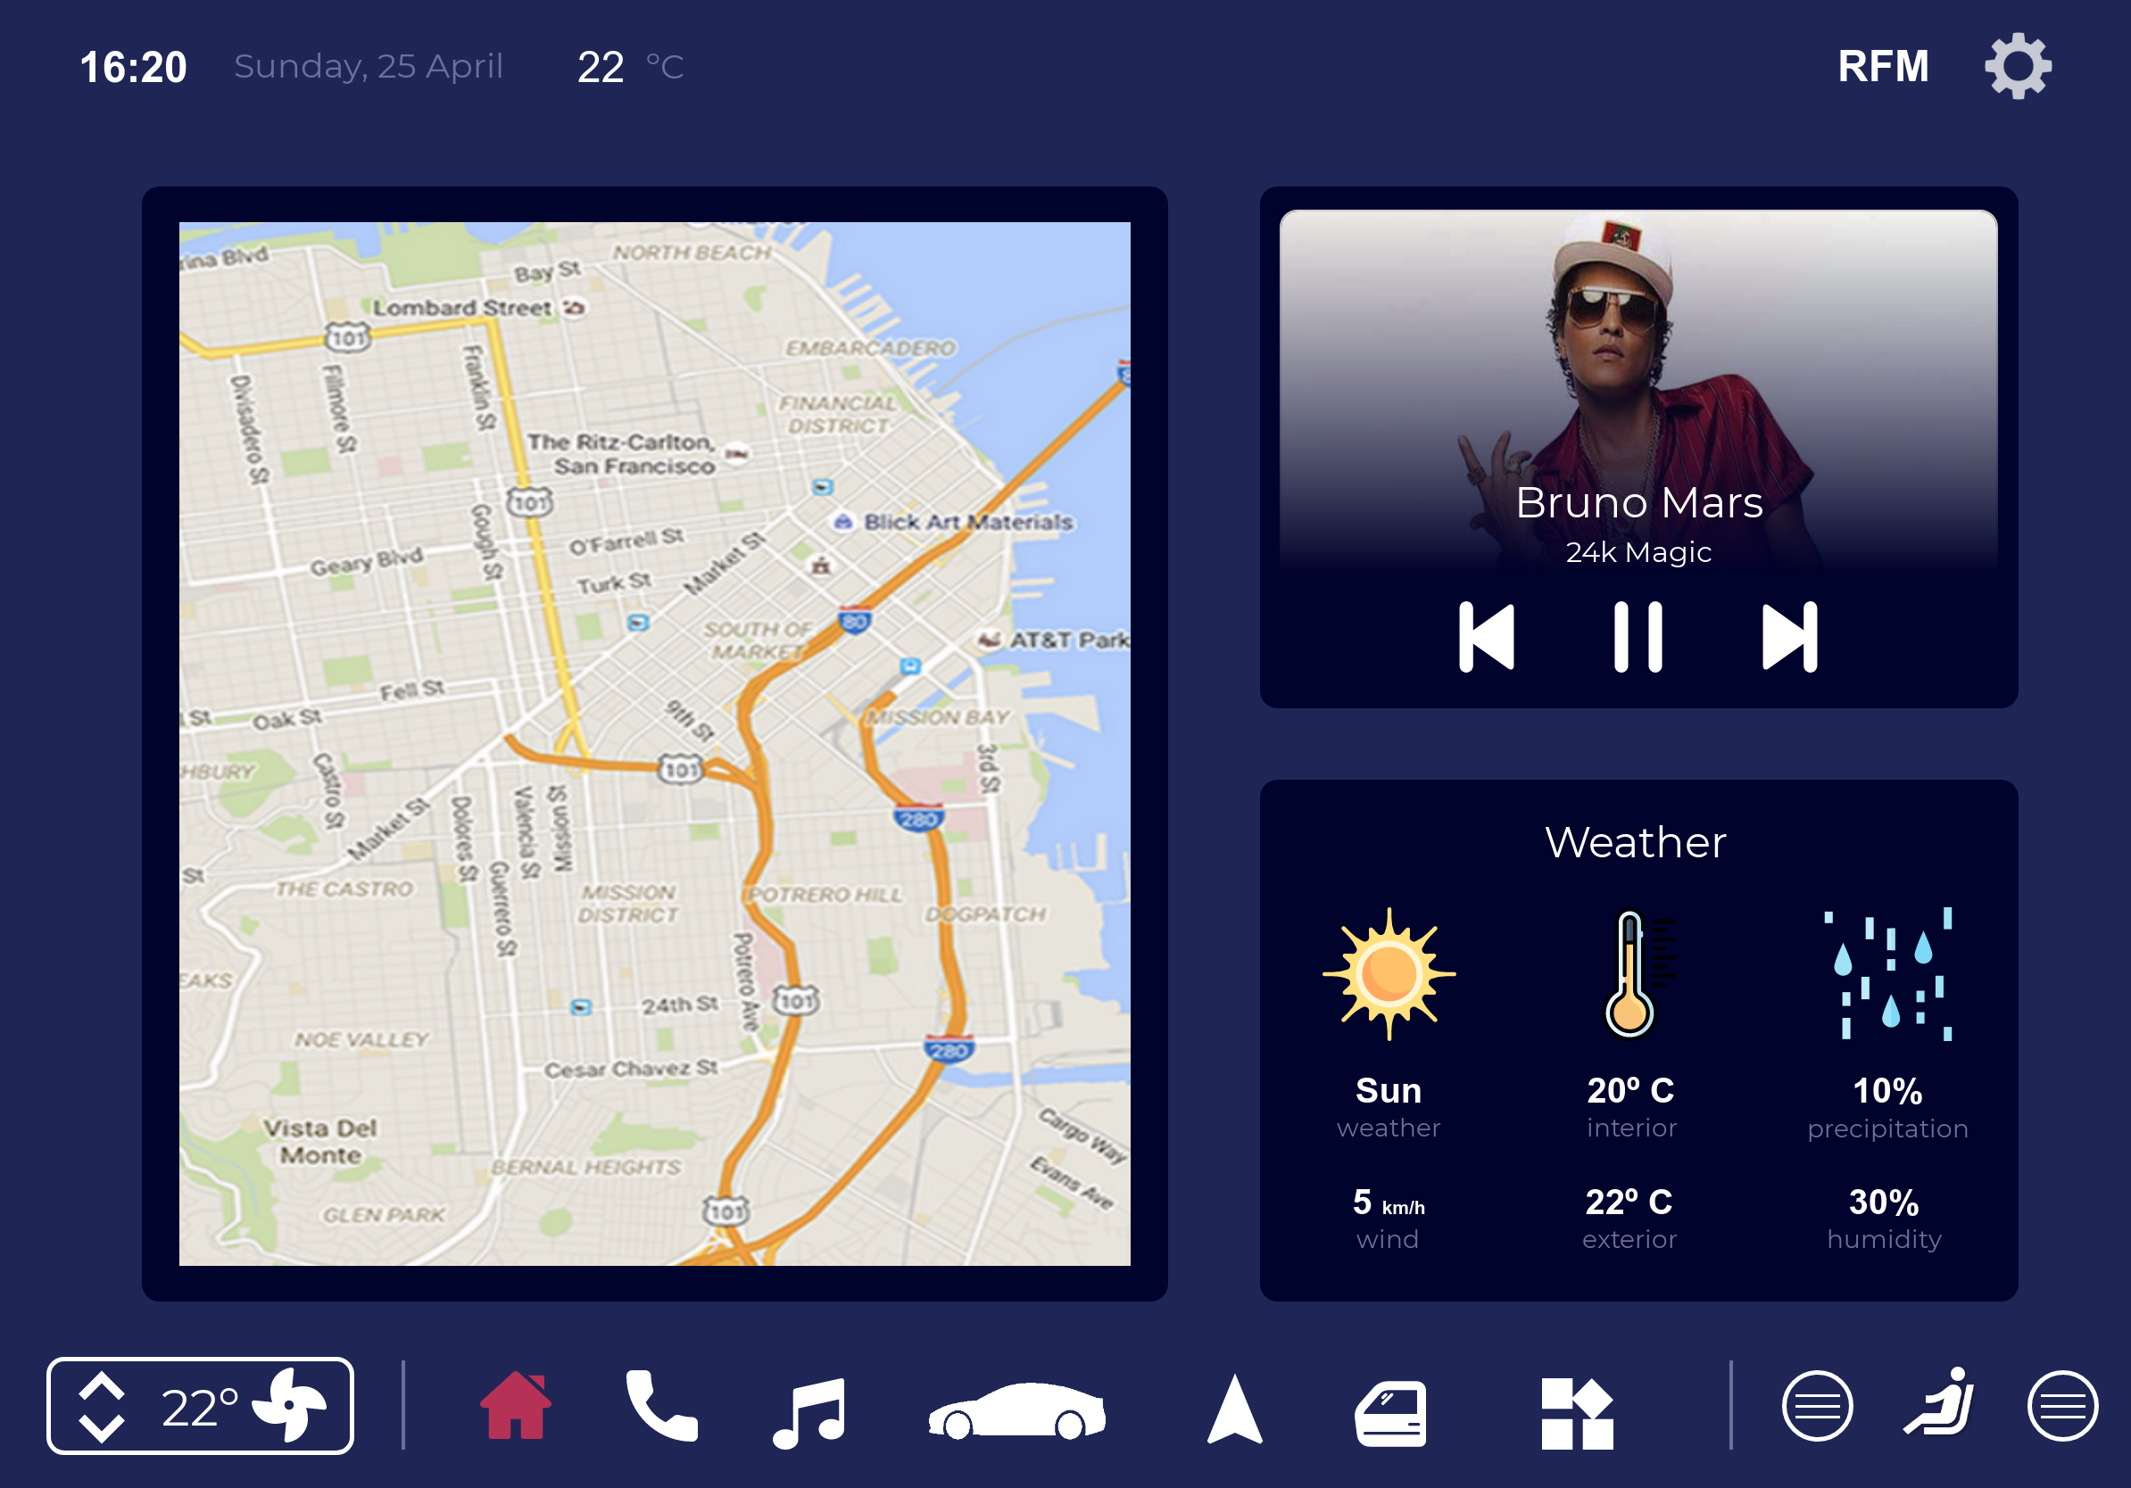
Next steps
Insert project title here
What type of prototype are you considering? (Paper or digital prototype?)
How will you test it?
(examples from previous editions
of the IHC course – many thanks to their authors!)
HCI 2020 - 2021
8

